Slide 1
Introduction to Multi-Agent Systems
Exploring autonomous agents working collaboratively
Notes:
AI-generated content may be incorrect. --- Welcome to the course on Multi-Agent Systems (MAS). This course explores how multiple autonomous AI agents work together to solve complex tasks in dynamic environments. We will examine the fundamentals of MAS, coordination, collaboration, architectures, and communication.

Slide 2
Course Agenda: Multi-Agent Systems
Slide 1: Course Title – Introduction to Multi-Agent Systems
Slide 2: Course Aim – What Are Multi-Agent Systems?
Slide 3: Key Challenge – Coordination & Collaboration
Slide 4: Agent Architectures – Reactive, Deliberative & Hybrid
Slide 5: Communication Protocols – Direct Vs. Indirect
Slide 6: Role Assignment – Efficient Division of Labor
Slide 7: Orchestration – Managing Collaboration
Slide 8: Collaborative Task Execution – MAS in Action
Notes:
In this course, we will cover the definition and aims of MAS, key challenges like coordination, various agent architectures, communication protocols, role assignment, orchestration, and real-world task execution examples.

Slide 3
Slide 1: Course Title – Introduction to Multi-Agent Systems
Notes:
This slide introduces the course title and welcomes students to MAS. It highlights the concept of AI agents working together and features an abstract AI network visualization to illustrate agent collaboration.

Slide 4

Welcome to MAS! Explore AI Agents Working Together
Multi-Agent Collaboration
Multiple autonomous agents work together to achieve complex and shared objectives efficiently.
Complex Goal Achievement
Agents coordinate their actions to solve problems that are complex for a single agent.
Networked Environment
Agents interact within a connected network enabling communication and coordination.
Notes:
--- Multi-Agent Systems involve multiple autonomous agents collaborating to achieve complex goals. This introduction sets the context for exploring the roles and interactions of these agents in a networked environment. Image source: Microsoft 365 content library

Slide 5
Slide 2: Course Aim – What Are Multi-Agent Systems?
Notes:
This section explains what constitutes a Multi-Agent System: multiple autonomous agents interacting within dynamic environments to solve complex tasks. It includes imagery of diverse agents in a digital landscape.

Slide 6

MAS: Multiple Autonomous Agents in Dynamic Environments
Independent Agent Operation
Agents in MAS act autonomously, making independent decisions without centralized control.
Agent Interaction and Coordination
Agents interact and coordinate their actions to achieve common goals in complex environments.
Problem Solving Collaboration
Collaboration among agents is essential for solving complex problems effectively within MAS.
Notes:
--- MAS consist of agents that operate independently yet interact to coordinate their actions. Understanding how these agents collaborate to solve problems is key to mastering MAS concepts. Image source: Microsoft 365 content library

Slide 7
Slide 3: Key Challenge – Coordination & Collaboration
Notes:
This section highlights the challenge of enabling agents with diverse skills and goals to work together smoothly, overcoming coordination obstacles that arise in MAS.

Slide 8

Agents Must Work Together Seamlessly
Coordination Importance
Coordination among agents is vital for achieving success in multi-agent systems.
Conflict Management
Agents must manage conflicts effectively to maintain smooth operation and reach goals.
Achieving Collective Goals
Synchronizing actions helps agents efficiently achieve shared objectives.
Notes:
--- Effective coordination and collaboration are critical for MAS success. Agents must synchronize their actions and manage conflicts to achieve collective goals efficiently. Image source: Microsoft 365 content library

Slide 9
Slide 4: Agent Architectures – Reactive, Deliberative & Hybrid
Notes:
This section introduces the main agent architectures including reactive agents that respond immediately, deliberative agents that plan actions ahead, and hybrids combining both strategies.

Slide 10

Reactive, Deliberative, and Hybrid Architectures
Reactive Agents
Reactive agents operate with simple, fast responses without complex reasoning or planning.
Deliberative Agents
Deliberative agents use reasoning and planning to make thoughtful decisions over time.
Hybrid Agents
Hybrid agents combine quick responses with strategic planning for complex environments.
Notes:
--- Reactive agents are simple and fast, deliberative agents use reasoning and planning, while hybrid agents balance responsiveness with strategic thinking to adapt to complex environments. Image source: Microsoft 365 content library

Slide 11
Slide 5: Communication Protocols – Direct Vs. Indirect
Notes:
Here, we examine how agents communicate directly via messaging or indirectly through shared environments to coordinate and collaborate effectively.

Slide 12
Direct and Indirect Communication Protocols
Direct Communication
Direct communication involves clear and explicit message exchange between agents for precise interactions.
Indirect Communication
Indirect communication uses environmental cues or shared data to enable agent coordination without direct messaging.
Importance of Both Protocols
Both direct and indirect communication protocols are essential for flexible and adaptable agent interactions.
Notes:
--- Direct communication involves explicit messages between agents, while indirect communication uses environmental cues or shared data. Both are essential for flexible agent interactions. Image source: Microsoft 365 content library

Slide 13
Slide 6: Role Assignment – Efficient Division of Labor
Notes:
This section discusses how assigning roles based on agent skills distributes workload effectively, enhancing overall system performance.

Slide 14
Assigning Tasks According to Agent Skills
Role Assignment Importance
Assigning roles ensures tasks go to capable agents, enhancing efficiency and effectiveness in multi-agent systems.
Workload Balancing
Proper task allocation balances workload among agents to prevent overburdening and optimize performance.
Optimized Collaboration
Collaboration improves when agents are assigned tasks matching their skills, leveraging strengths within the system.
Notes:
--- Role assignment ensures tasks are allocated to the most capable agents, balancing workload and optimizing collaboration within the MAS framework. Image source: Microsoft 365 content library

Slide 15
Slide 7: Orchestration – Managing Collaboration
Notes:
We explore orchestration strategies, comparing centralized and distributed control methods to schedule agent interactions and maintain system efficiency.

Slide 16
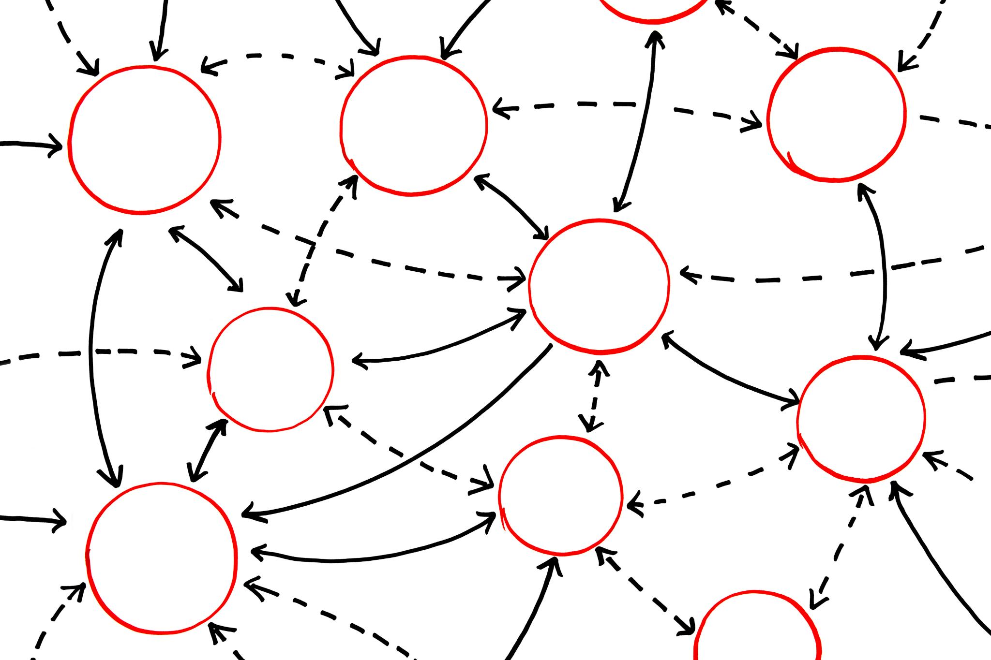
Centralized vs. Distributed Orchestration
Centralized Orchestration
A single controller manages all agents, providing unified control but potential scalability limits.
Distributed Orchestration
Agents self-organize without a central controller, enhancing scalability and robustness.
Trade-offs
Centralized offers control but less scalability; distributed offers robustness but complex coordination.
Notes:
--- Centralized orchestration uses a single controller to manage agents, while distributed orchestration allows agents to self-organize. Both approaches have trade-offs regarding scalability and robustness. Image source: Microsoft 365 content library

Slide 17
Slide 8: Collaborative Task Execution – MAS in Action
Notes:
This final section demonstrates MAS in practice with agents searching environments, coordinating transport tasks, and negotiating solutions to optimize outcomes.

Slide 18

Agents Executing Collaborative Tasks
Task Coordination
Agents coordinate tasks dynamically to achieve common goals efficiently in changing environments.
Negotiation Among Agents
Agents negotiate resource allocation and responsibilities to optimize overall task performance.
Efficient Problem Solving
Multi-agent systems facilitate efficient problem-solving through collaboration and adaptability.
Notes:
--- Through examples of task coordination and negotiation, we see how MAS enables efficient problem-solving in dynamic, real-world scenarios. Image source: Microsoft 365 content library

Slide 19
Conclusion
Fundamental Concepts
The course covers core principles of Multi-Agent Systems essential for understanding agent-based solutions.
Agent Collaboration
Agents work together effectively to solve complex problems through collaboration and communication.
Role Management and Orchestration
Managing agent roles and orchestrating their interactions enables efficient task completion in complex environments.
Notes:
This course introduces the fundamental concepts of Multi-Agent Systems, focusing on agent collaboration, architectures, communication, role management, and orchestration to solve complex tasks effectively.

